Slide 1
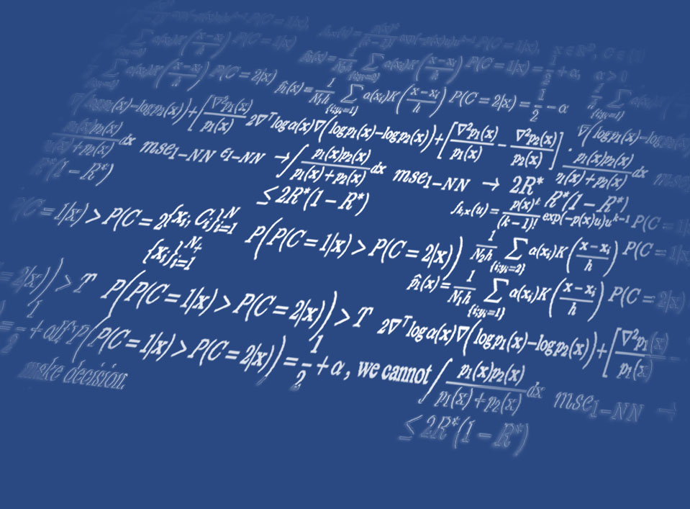


Hands-on with Diffusion Models: Code Examples
한양대학교 인공지능학과
Diffusion Model Bootcamp
2025. 2. 4 (Tue.)
Yung-Kyun Noh (노영균)
Hanyang University &
Korea Institute for Advanced Study (KIAS)
Hanyang University
Notes:
https://indico.ibs.re.kr/event/571/

Slide 2
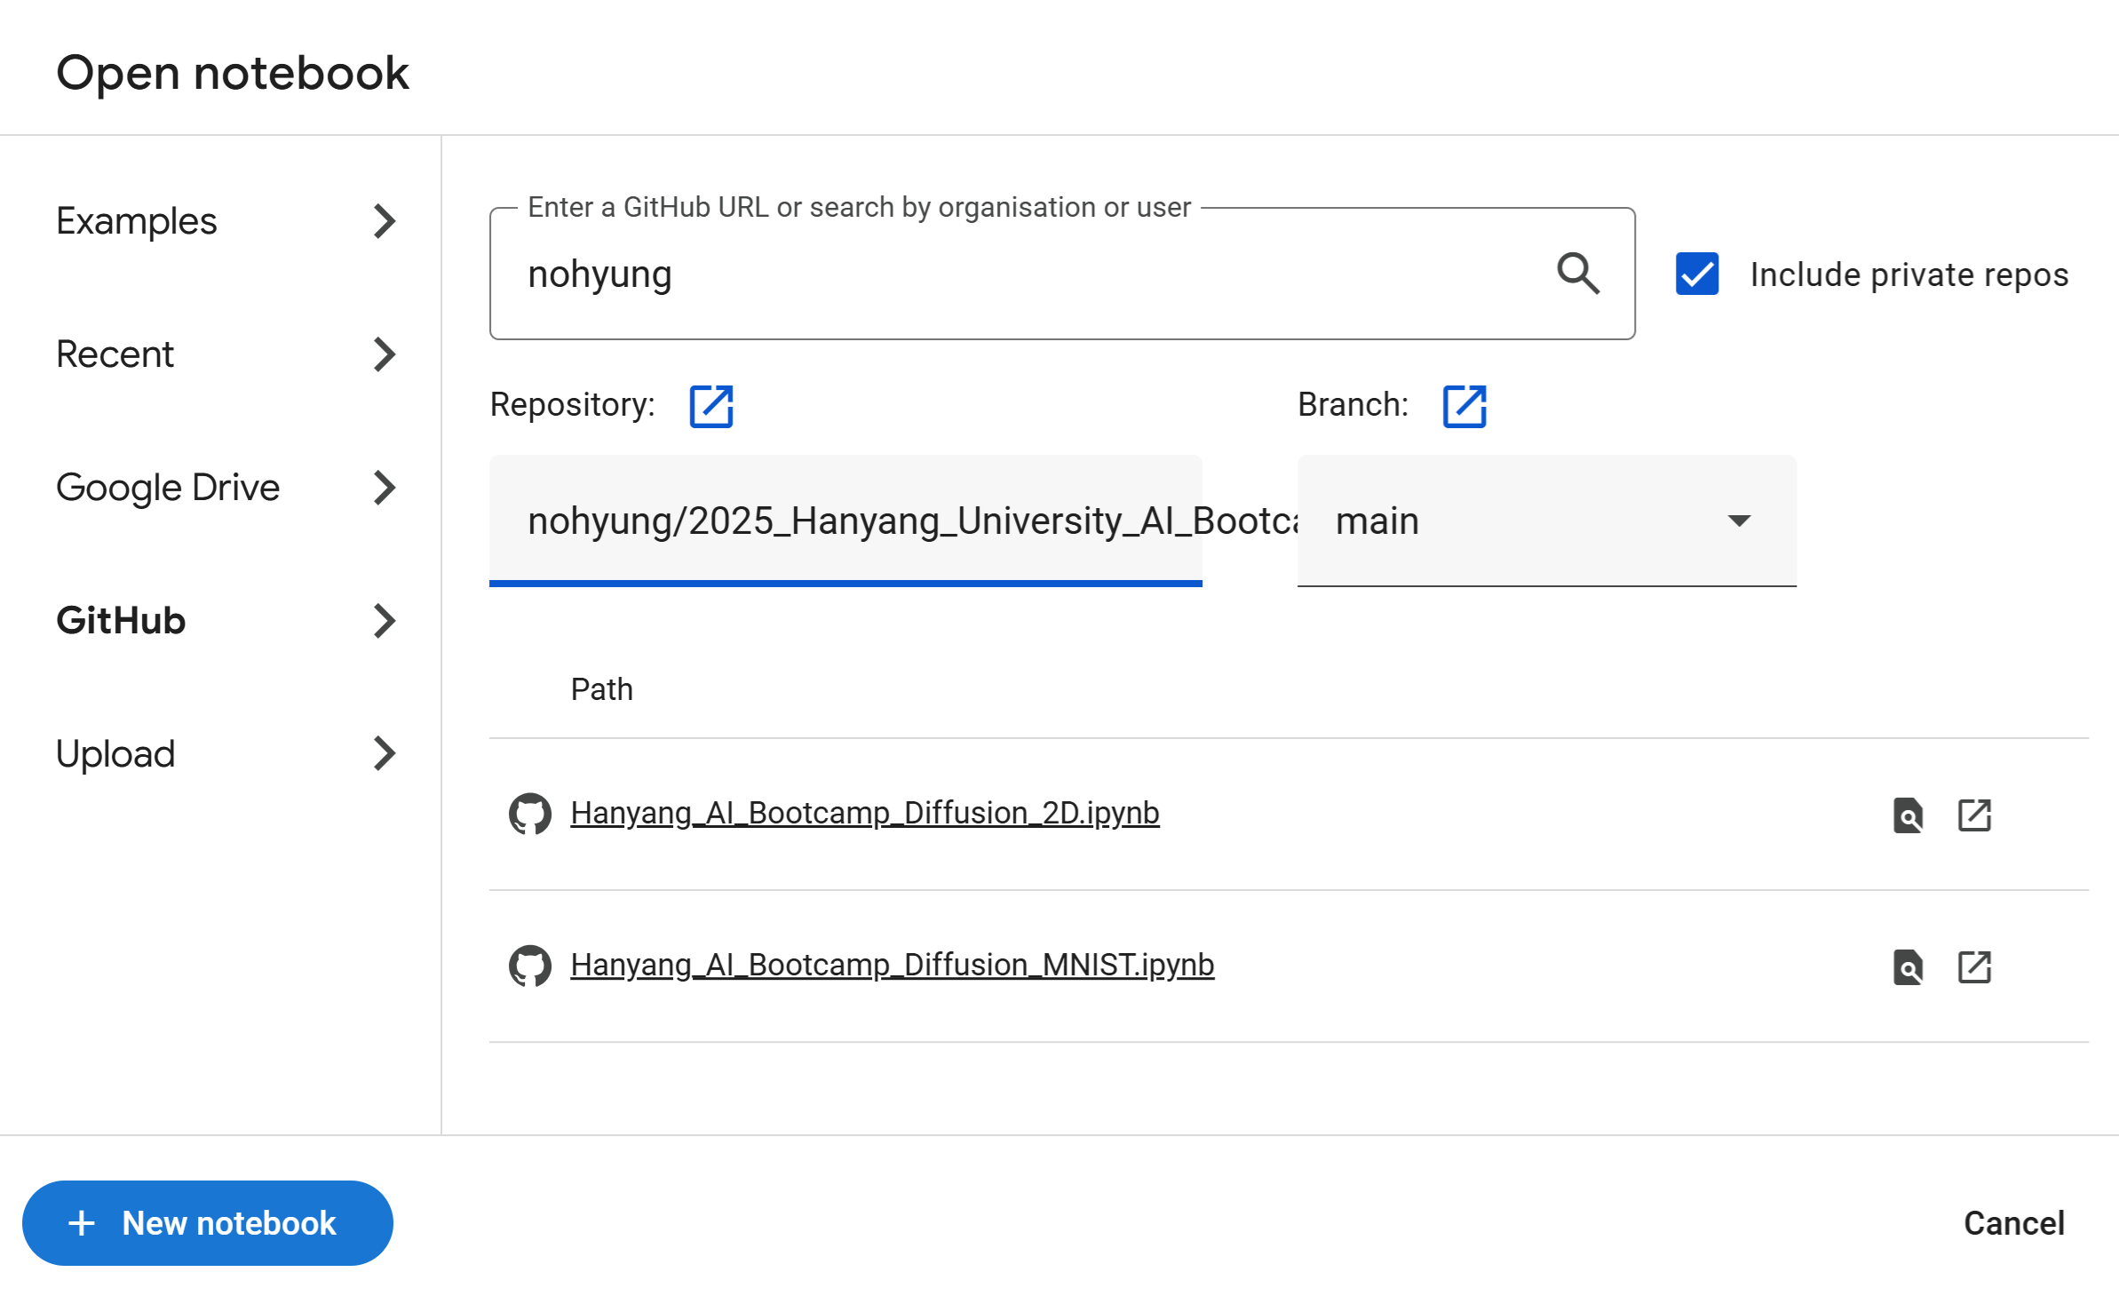
Hands-on Experiment
github.com/nohyung → 2025_Hanyang_University_AI_Bootcamp
https://github.com/nohyung/2025_Hanyang_University_AI_Bootcamp
Colab
https://colab.research.google.com/
Open -> Github -> nohyung -> 2025_Hanyang_University_AI_Bootcamp

Slide 3
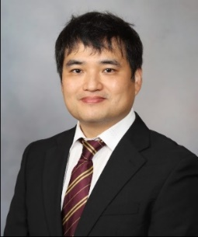
Yung-Kyun Noh (노영균)
Academic titles (Affiliations)
Associate Professor, Department of Computer Science, Hanyang University
Affiliate Professor, School of Computational Sciences, Korea Institute for Advanced Study (고등과학원)
Research Collaborator, Department of Gastroenterology and Hepatology, Mayo Clinic Rochester (US)
Visiting Scholar, RIKEN Center for Advanced Intelligence Project (Japan)
Chair, Dept. of Artificial Intelligence (인공지능대학원),Dept. of Intelligence and Convergence (지능융합학과), Dept. of Artificial Intelligence Application (AI응용학과) Hanyang University

Slide 4
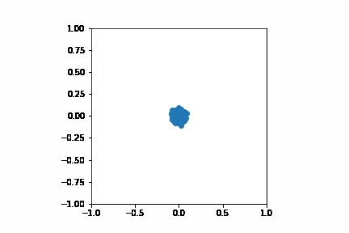
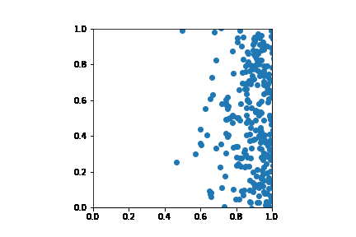
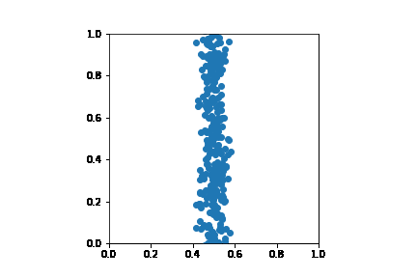
Diffusive Flow

Slide 5
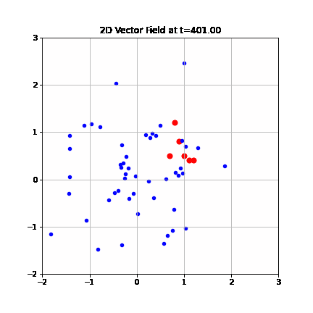
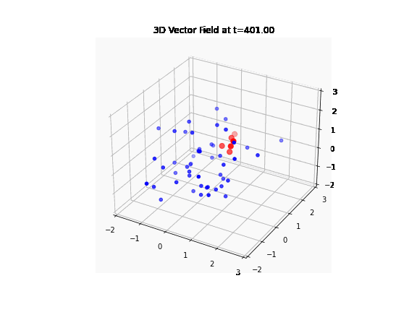
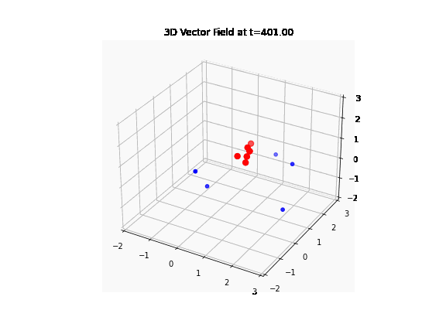

Slide 6
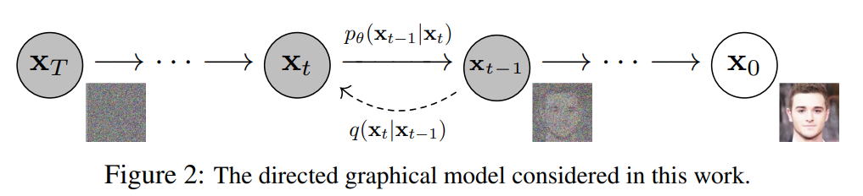
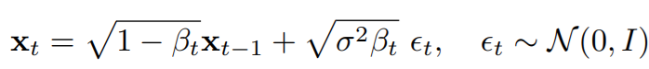
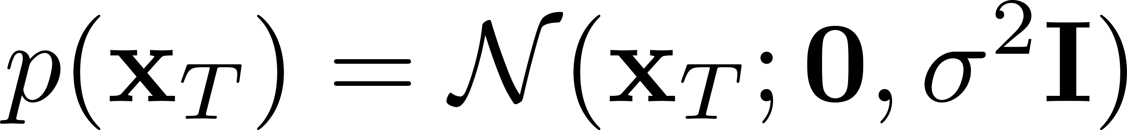
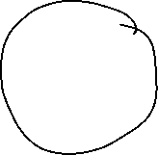
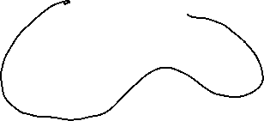
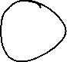
Diffusion Models
Data
Diffuse & Reverse the diffusion
Notes:
All the fancy ideas such as classifier-free guidance

Slide 7
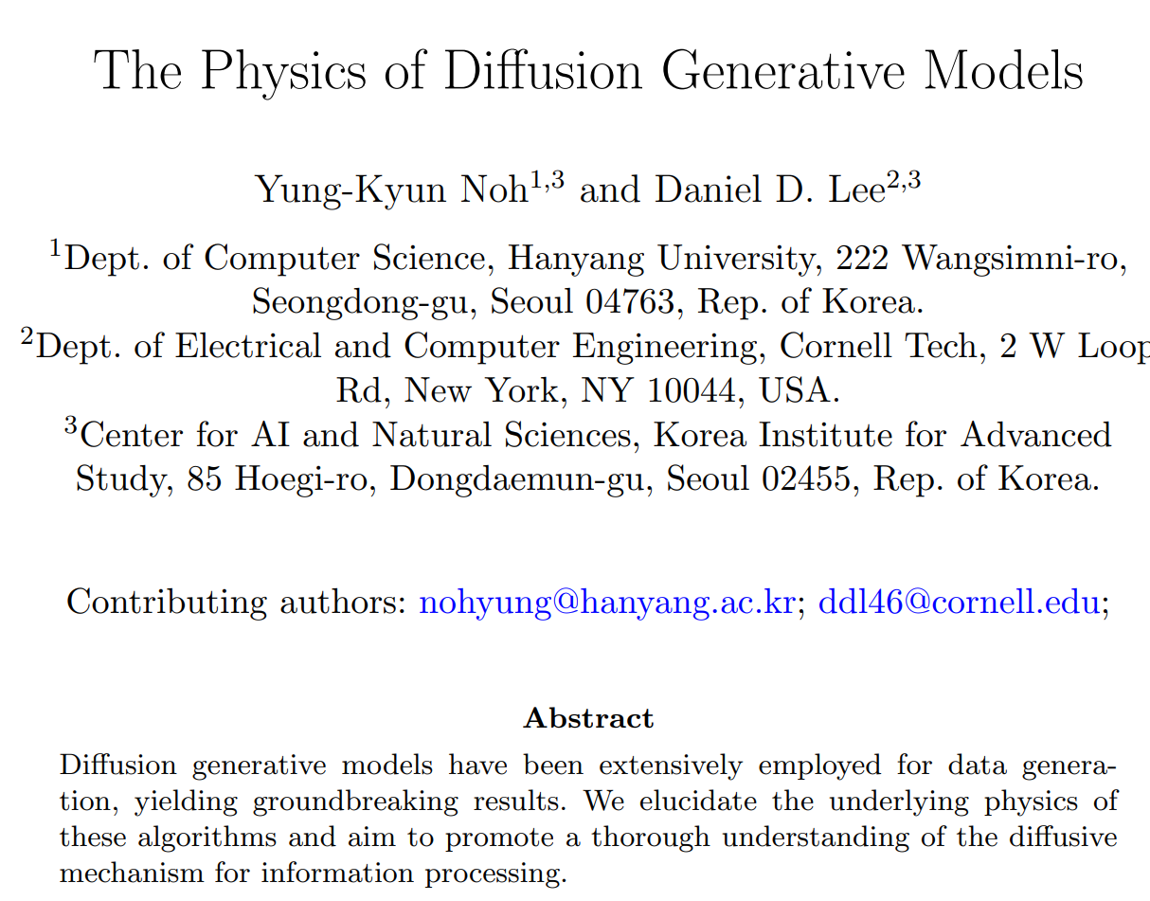
To appear…

Slide 8


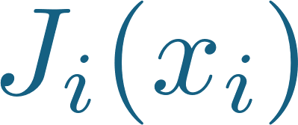
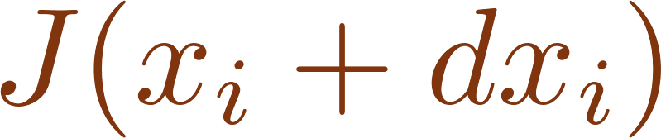
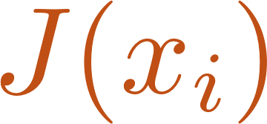
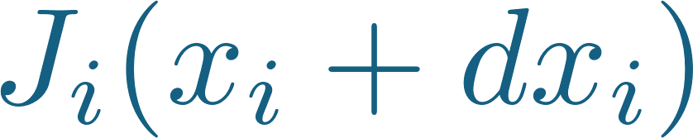
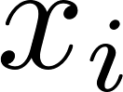
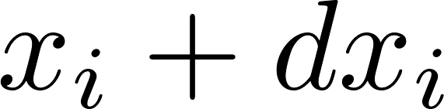
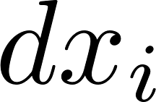

Slide 9
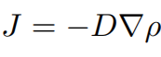
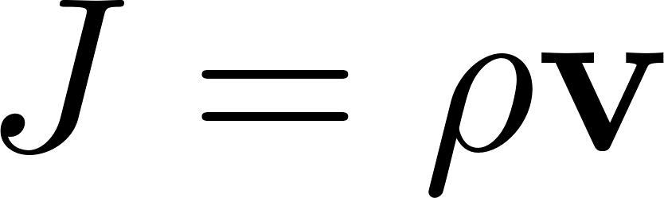
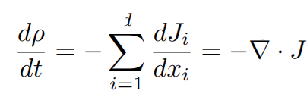
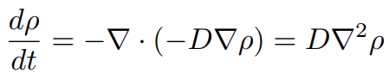


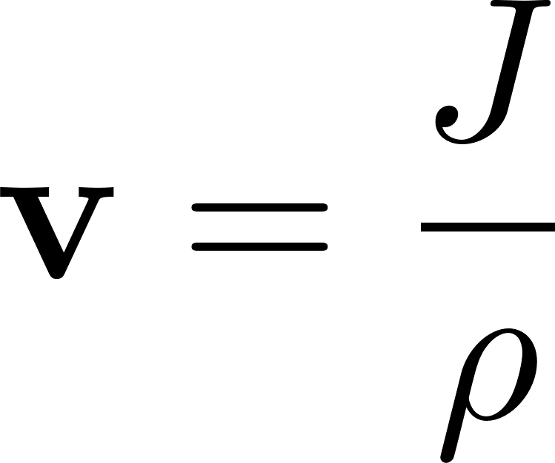
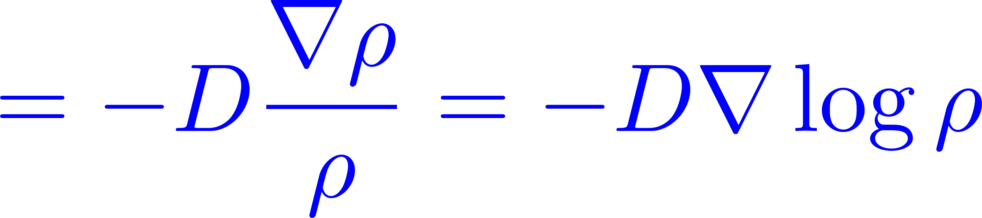
Diffusion in Physics
Coherent diffusive velocity even with randomness of diffusion
Diffusivity
Fick’s law
Notes:
Because flux is momentum, we sense the momentum. We do not have much insight on velocity.
J는 매개체. J의 flow가 v에 따라 일어나고, 이것이 density의 변화를 일으키는 방식이 Fokker-Plank. Density가 만든 변화를 거꾸로 만드는 것이 관건.

Slide 10



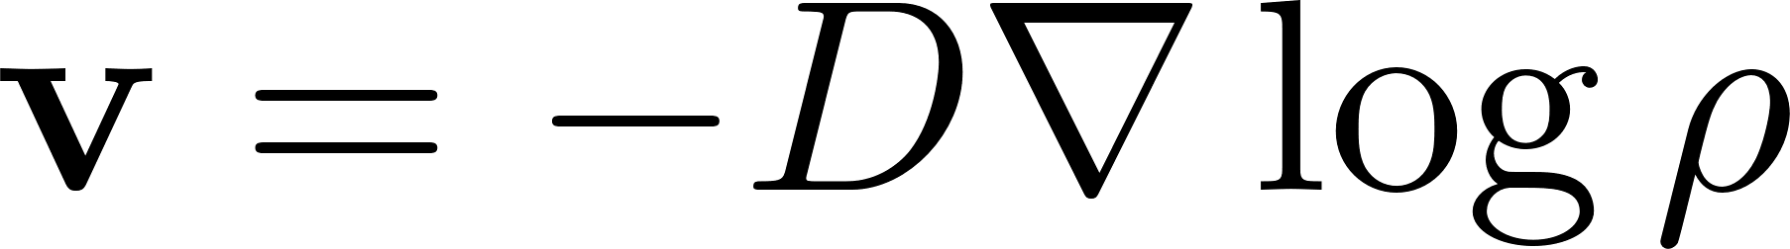
Control and Diffusive Flow
No control!
Notes:
Pure diffusion

Slide 11

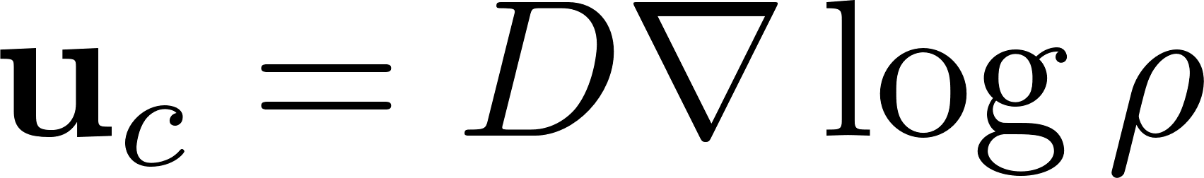

Control and Diffusive Flow

Slide 12

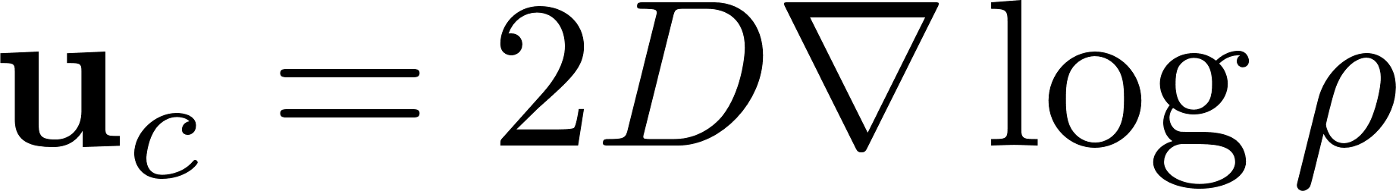
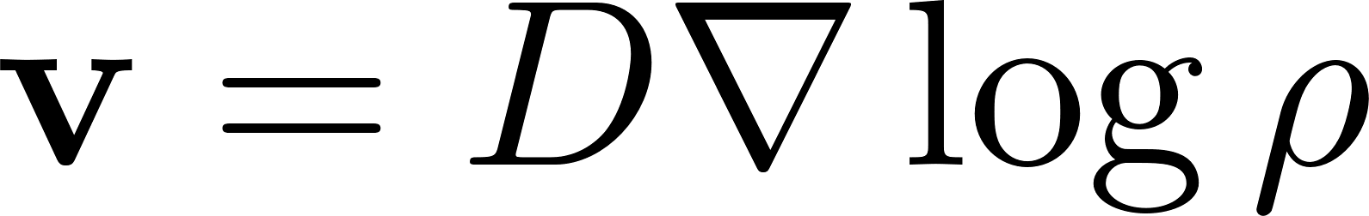
Control and Diffusive Flow

Slide 13

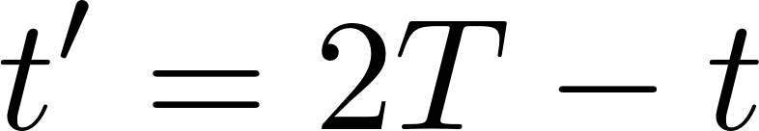





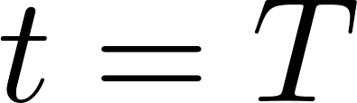
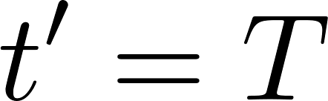
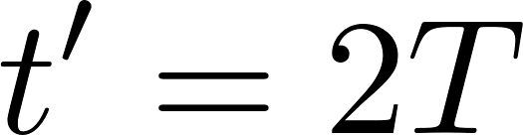
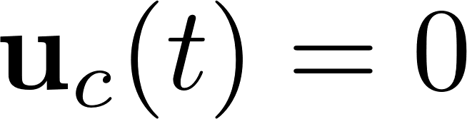
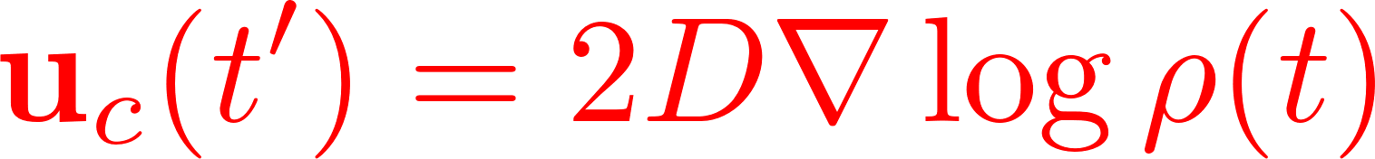
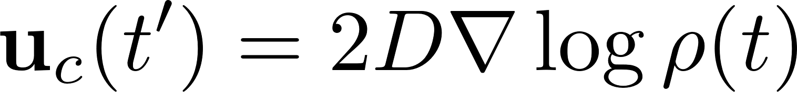
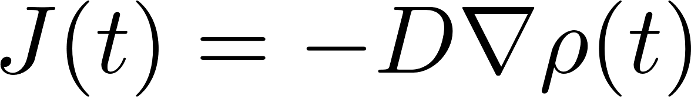
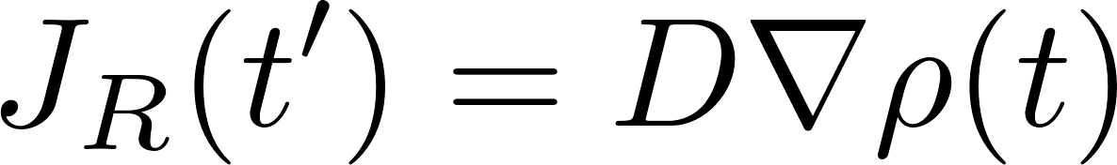
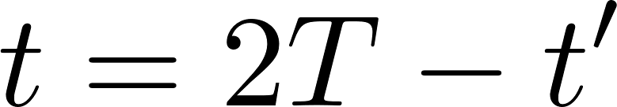
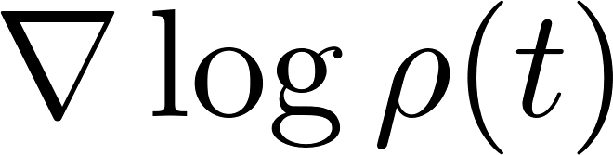
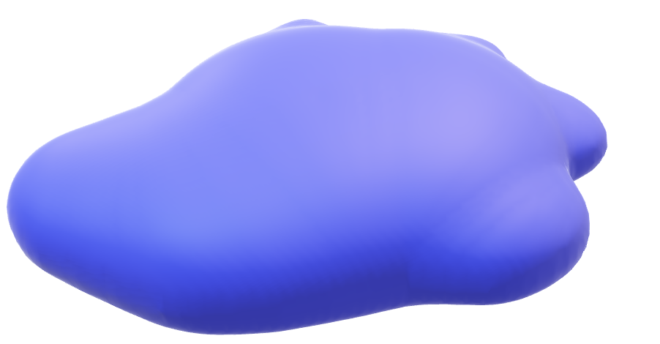
(Continuous-time) Reverse Process in Physics
Diffusion
Reverse process
Memorize
during diffusion

Slide 14
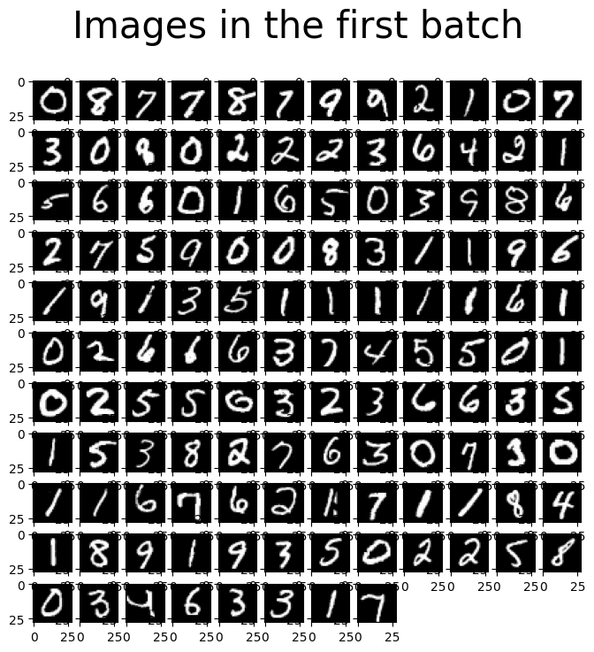

Slide 15
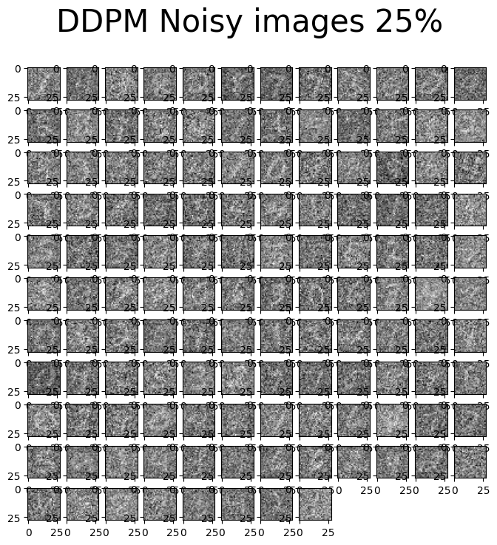

Slide 16
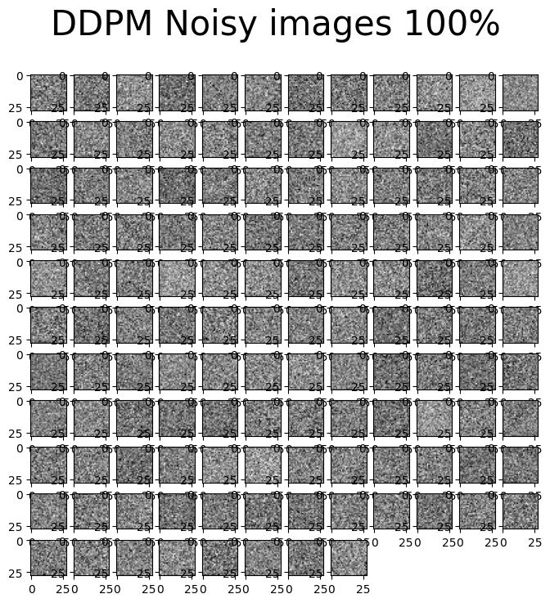

Slide 17
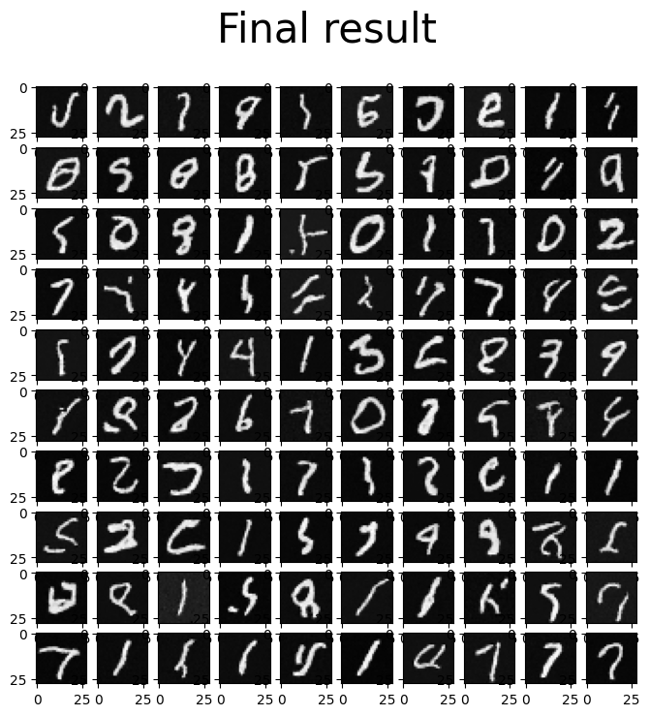

Slide 18
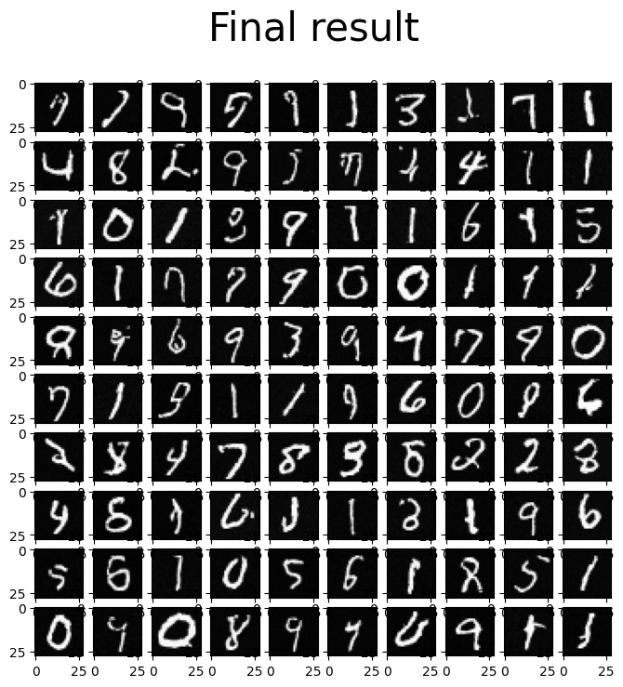

Slide 19







Guidance & Class-Conditional Densities
Learn with
Learn with
Notes:
Reverse flow
Control the points to make the reverse flow.

Slide 20






Guidance & Class-Conditional Densities

Slide 21

Guidance & Class-Conditional Densities
Classifier-free guidance

Slide 22


Smaller # of params
Larger # of params

Slide 23


Smaller # of params
Larger # of params

Slide 24


Smaller # of params
Larger # of params

Slide 25

nohyung@hanyang.ac.kr
Notes:
이상입니다. 경청해 주셔서 감사 드립니다.

